Slide 1

AI Smart Library Assistant & Management System
SOA Project Review-1
Date& Time
 | Under the Guidance of Dr. Neelima Gogineni SOA Professor, Department of Computer Science and Engineering, KLH CSE Bowrampet Campus
Name | Roll.NO
P. Likith Sai | 2420030066
K. Vishnu Priya | 2420030630
B. Nagaraju | 2420030614

Slide 2
Outline of Project Work
Focus
Introduction
Literature Survey
Challenges
Research Objectives
Conclusion & Future Work
References
Publications Details

Slide 3
Problem Statement
Traditional library management systems rely heavily on manual processes, making book searching, tracking, issuing, and returning time-consuming and inefficient. Users often face difficulties in finding relevant books, while librarians struggle to manage large collections and maintain accurate records. Additionally, the lack of intelligent recommendations and instant user support reduces the overall library experience. Therefore, there is a need for an AI-powered smart library system that automates library operations, improves accessibility, and provides personalized assistance to users.

Slide 4
Objectives
Develop an AI-powered smart library management system.
Automate book issue, return, and reservation processes.
Provide fast and efficient book search functionality.
Recommend books based on user interests and reading history.
Assist users through an AI chatbot for library-related queries.
Maintain accurate records of books and users.
Generate reports and analytics for efficient library management.
Improve the overall user experience and accessibility of library services.

Slide 5
Literature Survey
Authors | Title of the Paper | Methodology | Inferences | Limitation / Future Work
M. Musto, G. Semeraro, P. Lops (2016) | Semantics-Aware Recommender Systems for Digital Libraries | Content-Based Filtering and Semantic Analysis | Improved personalized book recommendations for library users. | Needs larger datasets and better user profiling for higher accuracy.
J. Tejeda-Lorente et al. (2014) | A Recommendation System for Digital Libraries Based on User Profiles and Semantic Filtering | Semantic Filtering and User Preference Analysis | Enhanced discovery of relevant books and resources. | Performance decreases when user history is limited.
A. S. Ghareb, A. A. Bakar, A. R. Hamdan (2019) | Hybrid Recommendation System for Library Services | Hybrid Recommendation (Collaborative + Content-Based Filtering) | Provides more accurate recommendations than traditional methods. | Requires continuous updating of user preference data.
Proposed System | AI Smart Library Assistant & Management System | AI Chatbot, NLP Search, Recommendation Engine, Automated Library Management | Combines intelligent search, recommendations, and library automation in a single platform. | Future enhancements include voice assistant, mobile application, and cloud deployment.

Slide 6
Problem Gap Identification
Existing System | Gap Identified | Proposed Solution
Manual book management | Time-consuming and error-prone | Automated library management
Basic keyword search | Difficult to find relevant books | AI-powered smart search
No personalized recommendations | Users may miss useful books | AI-based book recommendation system
Limited user support | Delays in resolving queries | AI chatbot assistance
Manual tracking of issued books | Risk of record inaccuracies | Real-time tracking and notifications
Traditional reporting methods | Lack of insights and analytics | Automated reports and dashboards
Gap Statement:
Current library systems lack intelligent assistance, personalized recommendations, and automation. The proposed AI Smart Library Assistant & Management System bridges this gap by integrating Artificial Intelligence, smart search, automated management, and real-time user support.

Slide 7
Innovation, Creativity, and Novelty
AI-Powered Book Recommendation System that suggests books based on users' interests and reading history.
Intelligent Library Chatbot for instant assistance and answering user queries.
Natural Language Search allowing users to search books using simple sentences.
Automated Book Issue, Return, and Fine Management to reduce manual effort.
Real-Time Notifications for due dates, reservations, and book availability.
Personalized Reading Experience through AI-driven recommendations and analytics.
Smart Admin Dashboard for efficient monitoring and management of library resources.
Novelty:
The system combines Library Management, AI Recommendations, NLP-based Search, and Chatbot Assistance into a single platform, creating a smarter and more user-friendly digital library experience.

Slide 8
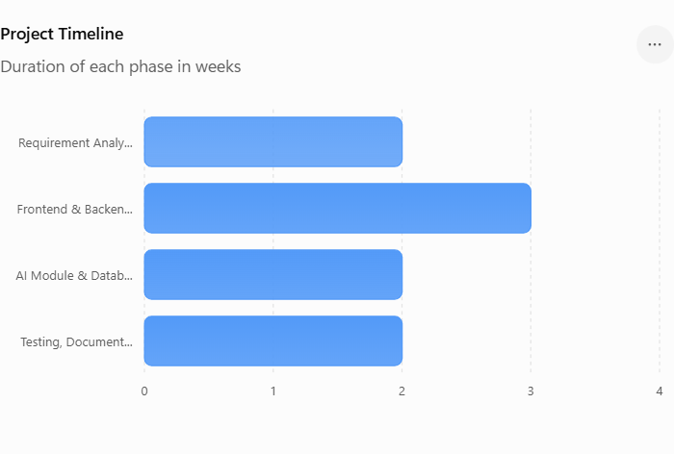
Feasibility and Project Plan
The AI Smart Library Assistant & Management System is feasible to implement using technologies such as Python, React, MongoDB, and AI-based recommendation models. The system is cost-effective, easy to develop, and suitable for educational institutions and libraries.
Technical Feasibility
Uses open-source technologies.
Easy integration of AI features.
Simple deployment and maintenance.
Economic Feasibility
Low development cost.
No expensive hardware required.
Minimal operational expenses.
Operational Feasibility
Easy for students and librarians to use.
Improves efficiency and reduces manual work.

